Slide 1
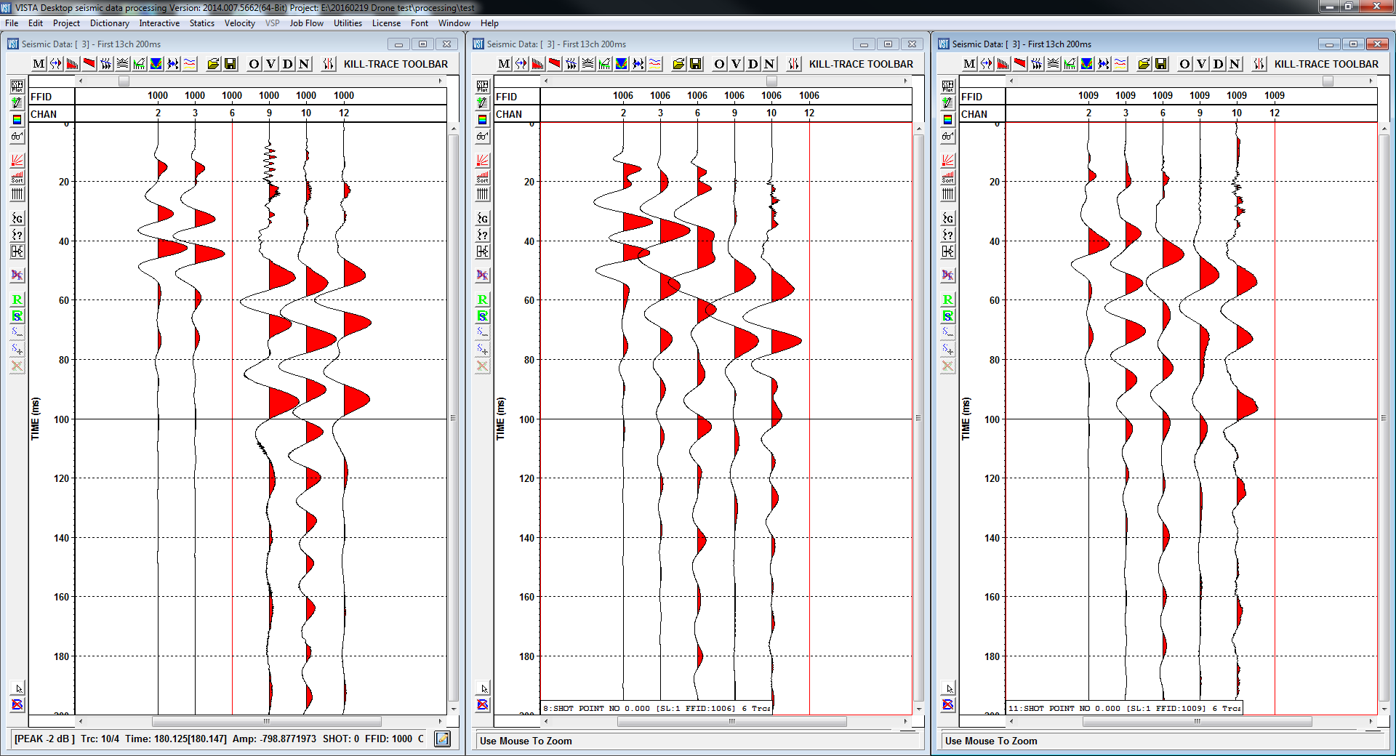
Data comparison
Well plant
Wooden platform
Drone
ok plant
round platform

